Slide 1
Processes & Threads Processes

Slide 2
Objectives
Processes
Definition
The process model
Process creation
Process hierarchies
Process Termination
Process States
Transition States
Implementation of Processes
Degree of multiprogramming

Slide 3
Definition
Processes
OS abstraction to support the ability to have (pseudo) concurrent operation even when there is only one CPU available
An OS consists of a collection of processes: By switching the CPU between processes, the OS can make the computer more productive
An instance of an executing program, including the current values of PC, registers, and variables
A process is not a program on the disk (this is just a file).
Compare with a cake recipe (program) and the activity involving reading the recipe, fetching ingredients, and baking the cake! (process)
A process is a sequential stream of execution in its own address space

Slide 4
Processes
The process model
Early computers allowed only one program to be executed at a time. (quantum or time slice)
The program is a static (inactive) entity, whereas the process is an active one
A process is an activity of some kind
A process has a program, input, output, and a state
There are two parts of a process
sequential execution: no concurrency inside a process; everything happens sequentially (There is only one CPU and one physical program counter)
process state: everything that process interacts with (registers, memory, files, etc)
Notes:
Process Model
Pseudo-parallelism (Multi-programming, quantum or time slice)
Context Switch (user mode ↔ kernel mode, switch CPU to other process – load/store PCB)
Scheduling algorithm

Slide 5
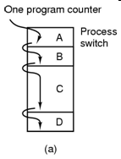
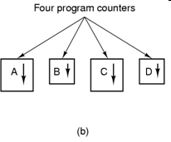
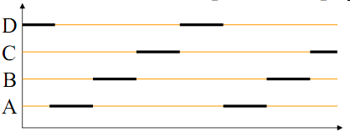
Example
Tanenbaum, Fig. 2-1.

Slide 6
Processes The process model (cont)
Single-processor systems
Pseudo-parallelism
Multiprogramming
Switching among processes (The CPU switches back and forth from process to process)
A single processor may be shared among several processes
Scheduling algorithm
Context switch
Switching the CPU to another process requires saving the state of the old process and loading the save state for the new process
Context switch time is pure overhead because the system does not usually work while switching. Time varies depending on the hardware machine
Has become a performance bottle neck
Notes:
Process Model
Pseudo-parallelism (Multi-programming, quantum or time slice)
Context Switch (user mode ↔ kernel mode, switch CPU to other process – load/store PCB)
Scheduling algorithm

Slide 7
Processes Process Creation
In a general-purpose OS, the principal events that may cause process creation are:
System initialization
Execution of a process creation system call by a running process
A user request to create a new process
Initiation of a batch job
Automatically by the system
At system initialization
Foreground (application) and background (services) processes
By another process
A system call for process creation
Situations
A process needs help doing some computation
A user action – interaction with the shell
In general, a process (parent process) may create new processes (children) via a create-process system call:
fork() and execve() in UNIX
CreateProcess in Win32\

Slide 8
Processes Process Hierarchies
Process hierarchy
Parent–Child Relationship
The child can itself create new processes
Tree of processes
In UNIX OS
A process creates another process, the parent process and child process continue to be associated in certain ways
A process and all of its children and further descendants together form a process group
In Windows OS
All processes are equal (has no concept of process hierarchy)
The parent is given a special token (called a handle) that it can use to control the child

Slide 9
Processes Process Termination
After a process has been created, it may terminate usually due to one of the following:
Normal exit (task accomplished) (voluntary)
Error exit (voluntary)
Ex: nonexistent files, insufficient or incorrect input
Fatal error (involuntary)
Ex: illegal instructions, division by zero etc.
Killed by another process (involuntary)
kill system call in Unix, or TerminateProcess in Win32.(in some systems, if the parent terminates)
Voluntary – using a special system call
Involuntary – receiving an interruption

Slide 10
Processes Process States
Running
Using the CPU at that instant (executed by the CPU) (or Instructions are being executed)
Ready
Runnable; temporarily stopped to let another process run; but the CPU available (or The process is waiting to be assigned to a process)
Blocked
Unable to run until some external event happens (or The process is waiting for some event to occur)
New (optional)
Waiting for same resources to be allocated (or The process is being created)
Terminated (optional)
Keeping same information about the exit state (or The process has finished execution)

Slide 11
Processes Transition States
New to Ready or Running
Ready to Running (dispatch)
its turn comes again
selected by the scheduler
Running to Ready (interrupt)
suspended by the scheduler
time slice expired
Running to Blocked (block)
wait for some event to occur
Blocked to Ready (ready)
the awaited event occurs
Running to Terminated (exit)
New
(optional)
Terminated
(optional)
Running
Blocked
Ready

Slide 12
Processes Implementation of Processes
OS maintains a process table
each process is allocated an entry – PCB (Process Control Block) (Where process is located)
used as a repository when the process is suspended or blocked
A PCB contains all the information, that needed (varies from system to system) so that a process can be restarted as if it had never been stopped, such as
Process ID
process state (new, ready, running …)
the value of the CPU registers (PC, Stack Pointer, other register)
CPU scheduling information (process priority etc.)
memory management information (pointers etc.)
accounting information (the amount of CPU and real time used, time limits etc.)
I/O status information (outstanding I/O req., I/O devices allocated, list of open files etc.)
Process parent Id, process group ...

Slide 13
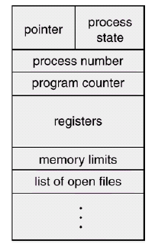
Processes Implementation of Processes (cont)
A PCB block

Slide 14
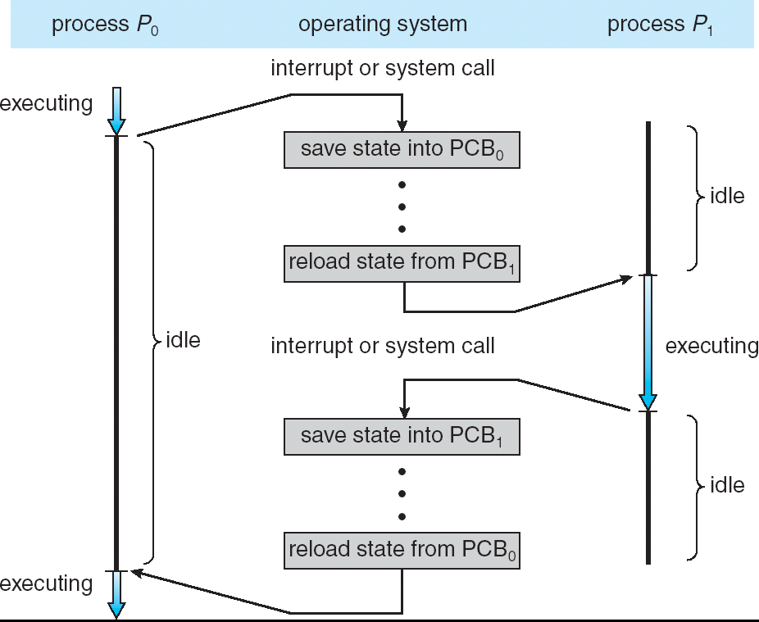
Processes Implementation of Processes (cont)
Example
Latency time (CPU Switch)

Slide 15
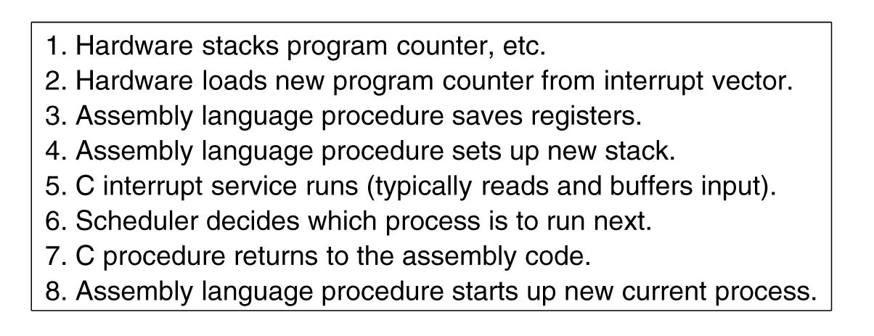
Processes Implementation of Processes (cont)
Interrupt handling and scheduling are summarized
Tanenbaum, Fig. 2-5.

Slide 16
Processes Degree of multiprogramming
Shows the CPU utilization
CPU utilization = 1 - p^{n}
p: time waiting for I/O to complete
n: number of processes
Example
A computer has 512MB of memory, with OS taking 128 MB and each user program also taking up 128MB with an 80% average I/O wait
CPU utilization = 1 – 80%^{((512-128)/128)} = 49%
Adding another 512MB,
CPU utilization = 1 – 80%^{((1024-128)/128)} = 79%

Slide 17
Processes & Threads Threads

Slide 18
Review
Process Model
Pseudo-parallelism (Multi-programming, quantum or time slice)
Context Switch (user mode ↔ kernel mode, switch CPU to other process – load/store PCB)
Scheduling algorithm
PCB
Id, registers, scheduling information, memory management information, accounting information, I/O status information, …
State (New, Running, Ready, Blocked, Terminal)
CPU Utilization
Shows the CPU utilization
1 – p^{n}

Slide 19
Objectives…
Threads
Overview
Models
Benefit
Implementing threads in User Space
Implementing threads in the Kernels
Hybrid Implementations
Scheduler Activations
Pop-Up threads
Making Single Threaded Code Multithreaded

Slide 20
Threads Context
Each process has an address space
The CPU is allocated only one process at one time
Context switching
Problems
First, (in Network Services)
We want to search something using the Google Web
Our request is transferred to web server that is busy with serving many client concurrently
So, the server can serve only one client at a time
Second, (in Word processor)
We uses the word processor to type the document
The word processor supports some of the features as automatically saving the entire file in every 5 minutes and display the graphics. Besides reading, he/she types on the keyboards,
So, when the automatically saving is executed, the reading or display can be not progressed

Slide 21
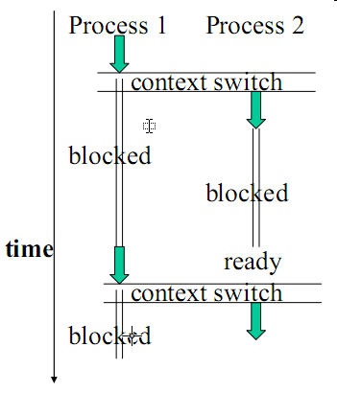
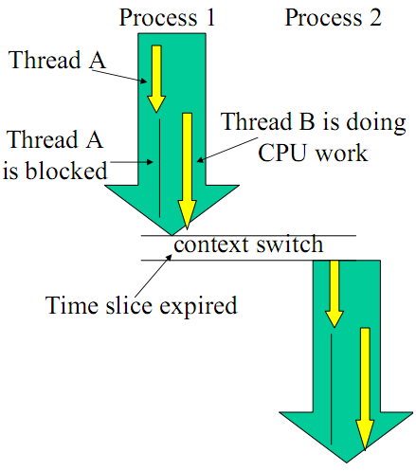
Threads Overview
It is desirable to have multiple threads of control in the same address space running in quasi-parallel, as though they were separate processes

Slide 22
Threads Models
Threads of one process (miniprocess)
Describe an sequential execution within a process
Share the same address space and resources of the process
Each thread has its own PC, registers and stack of execution
There is no protection between threads in one process
Lightweight processes (contains some properties of processes)
Have its own stack
Multithreading (multiple threads in same process)
Having multiple threads running concurrently within a process is analogous to having multiple processes running in parallel in one computer

Slide 23
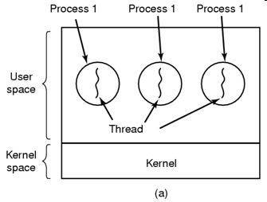
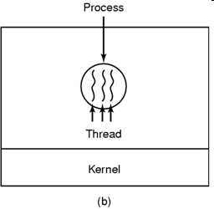
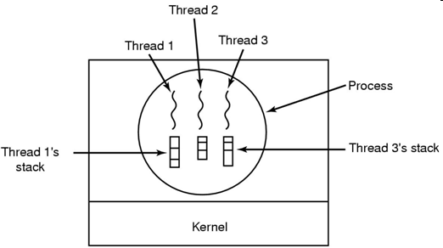
Threads Model (cont)
Tanenbaum, Fig. 2-11, 2-13.
Three processes each with one thread
Multiprogramming
One process with three threads
Multithreading

Slide 24
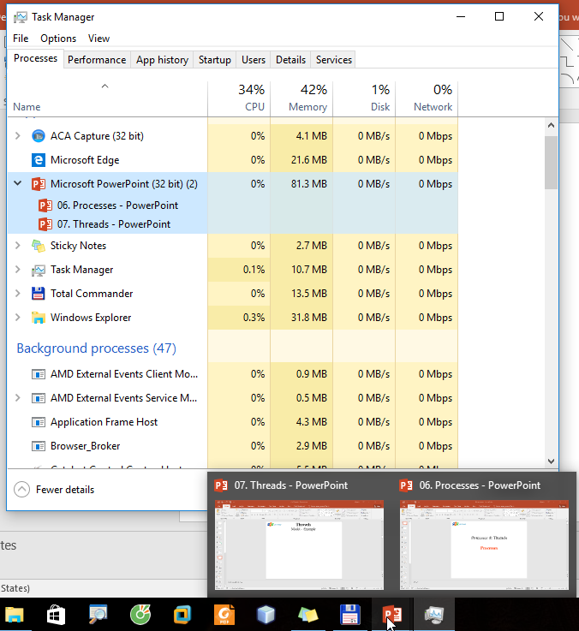
Threads Model – Example

Slide 25
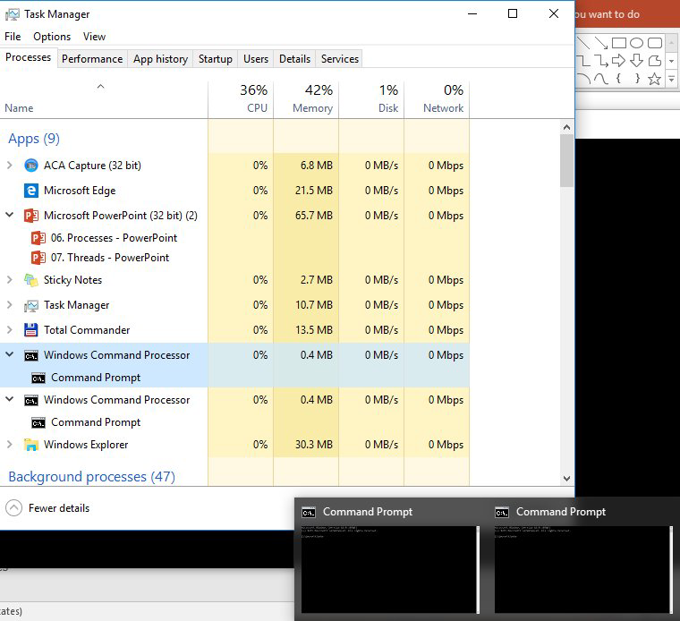
Threads Model – Example

Slide 26
Threads Benefits
Responsiveness and better resource sharing
A program may continue running even if part of it is blocked.
The application’s performance may improve since we can overlap I/O and CPU computation.
Economy:
Allocating memory and resources for process creation (faster, easier) is costly.
Thread creation may be up to 100 times faster! (Takes less time to create a new thread than a process)
Useful on systems with multiple CPUs.
Less time to terminate a thread than a process
Less time to switch between two threads within the same process (serve many task with the same purpose)
Since threads within the same process share memory and files, they can communicate with each other without invoking the kernel
But, they introduce a number of complications:
E.g., since they share data, one thread may read and another may write the same location – care is needed!

Slide 27
Threads Multithreading
Operating system supports multiple threads of execution within a single process
MS-DOS supports a single thread
UNIX supports multiple user processes but only supports one thread per process
Windows 2000, Solaris, Linux, Mach, and OS/2 support multiple threads
Multithread is effective in multiprocessors because the thread can execute in concurrently
…

Slide 28
Threads Implementing Threads in User Space
The kernel knows nothing about threads
The approach is suitable for OS that does not support threads
Threads are implemented by a user-level library (with code and data structure)
The threads run on top of a runtime system (which is a collection of procedures that manage threads)
Each process has its own thread table
Advantages
Thread switching and scheduling is faster (because it’s done at user mode) than to trapping the kernel mode
Each process can have its own customized scheduling algorithm
Scale better (can vary the table space and stack space in flexibility)
Disadvantages
The implementation of blocking system calls is complex → instead of blocking thread, the process is blocked
The need that a thread voluntarily gives up the CPU → The OS doesn’t know this, so if any user-level thread is blocked, the entire process is blocked
The developer wants threads precisely in applications → make system call constantly

Slide 29
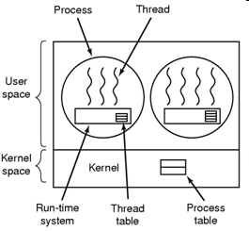
Threads Implementing Threads in User Space (cont)
Tanenbaum, Fig. 2-16.

Slide 30
Threads Implementing Threads in the Kernel
The kernel knows about the threads and manage the threads (no run-time system is needed)
The kernel schedules all the threads
The kernel has a thread table (using kernel call to create or destroy thread)
Advantages
The kernel can switch between threads belonging to different processes
No problem with blocking system calls
Useful if multiprocessor support is available (multiple CPUs)
Disadvantages
Greater cost (time and resources to manage threads create and terminate) → Solution: recycling
Thread creation, saving is slow (needs system call)

Slide 31
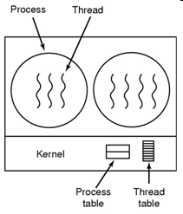
Threads Implementing Threads in the Kernel (cont)
Tanenbaum, Fig. 2-16.

Slide 32
Threads Libraries
There are 3 primitive libraries
POSIX Pthreads.
May be provided as either a user- or kernel-level library.
Win32 threads.
Kernel-level library, available on Windows systems.
Java threads.
JVM is running on top of a host operating system, the implementation depends on the host system.
On Windows systems, Java threads are implemented using the Win32 API;
UNIX-based systems often use Pthreads.

Slide 33
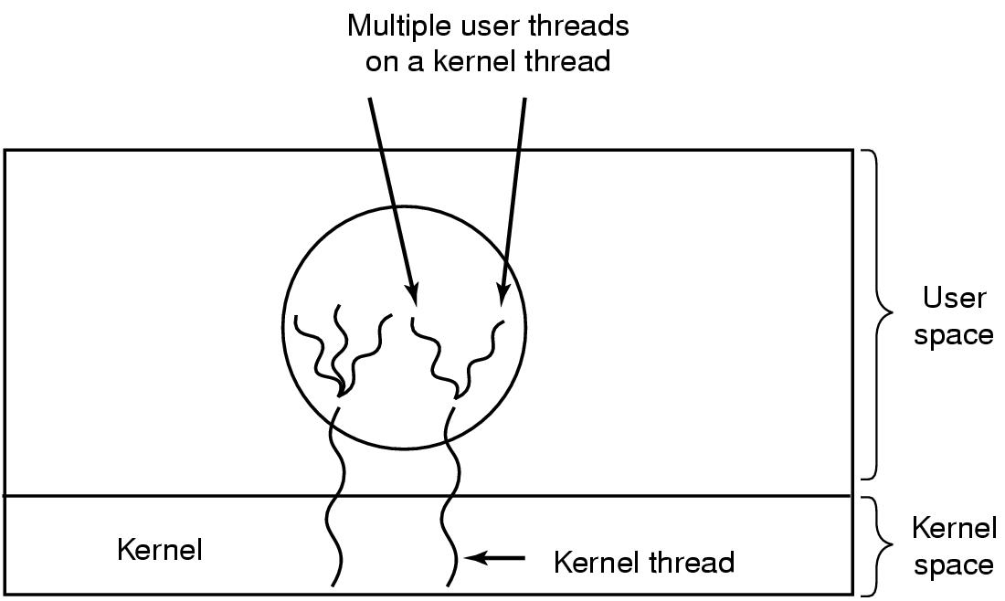
Threads Hybrid Implementations
Combine the advantages of user-level threads with kernel-level threads
Using kernel-level threads and then multiplex user-level threads onto some or all of the kernel threads (ultimate in flexibility)
Tanenbaum, Fig. 2-17.

Slide 34
Threads Scheduler Activations
Context
The kernel threads are better than user level threads but they are slower
When a thread blocks, other threads with in same process can be run
Avoiding unnecessary transitions between user mode and kernel mode
The user mode can block the thread and schedule a new one by itself
→ mimic the functionality of kernel threads and associate with threads packages implemented in user space (Scheduler Activations)
Upcall
The notified signal with information as thread’s ID and description is used to activate the runtime system
Scheduler Activation mechanism
When a thread has been blocked, the kernel make the upcall to the process’s runtime system (in user mode) to inform this event
The user mode can reschedule its threads by
Marking the current thread as blocked
Taking another thread from ready list, loading and restarting it
Later, when the blocked thread, that was marked, is ready and can run again, the kernel make another upcall
The runtime system can either restart the blocked thread immediately or put in on the ready list to be run later

Slide 35
Threads Scheduler Activations
Are to mimic the functionality of kernel threads, but with the better performance and greater flexibility usually associated with threads packages implemented in user space
The kernel assigns a certain number of virtual processors to each process and lets the (user-space) run-time system allocate threads to processors
Is efficient in reducing transition
The thread blocks waiting for another thread to do something, thus there is no reason to involve the kernel in transition

Slide 36
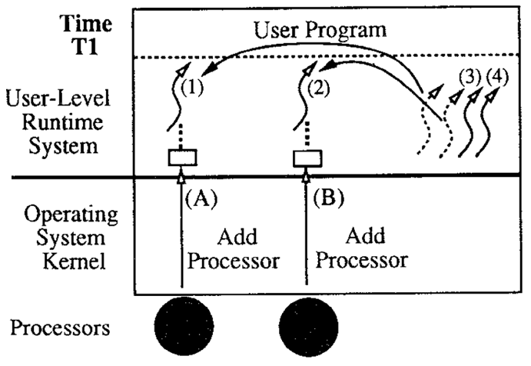
Threads Scheduler Activations – Example
T.E Anderson, Fig. 1 – Example I/O.
At time T1, the kernel allocates the application two processors. On each processor, the kernel upcalls to user-level code that removes a thread from the ready to running status.

Slide 37
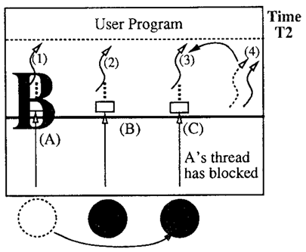
Threads Scheduler Activations – Example
T.E Anderson, Fig. 1 – Example I/O.
At time T2, one of the user-level threads (thread 1) is blocked in the kernel. To notify the user level of this event, the kernel takes the processor that had been running thread 1 and performs an upcall in the context of a fresh scheduler activation. The user-level thread scheduler can then use the processor to take another thread off the ready list and start running it.

Slide 38
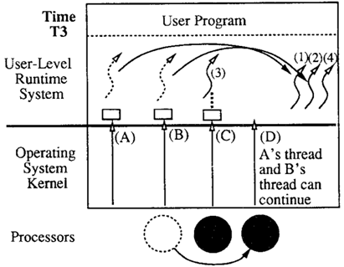
Threads Scheduler Activations – Example
T.E Anderson, Fig. 1 – Example I/O.
At time T3, the I/O completes. Again, the kernel must notify the user-level thread system of the event, but this notification requires a processor. The kernel preempts one of the processors running in the address space and uses it to do the upcall. (If there are no processors assigned to the address space when the I/O completes, the upcall must wait until the kernel allocates one). This upcall notifies the user level of two things: the I/0 completion and the preemption. The upcall invokes code in the user-level thread system that (1) puts the thread that had been blocked on the ready list and (2) puts the thread that was preempted on the ready list. At this point, scheduler activations A and B can be discarded.

Slide 39
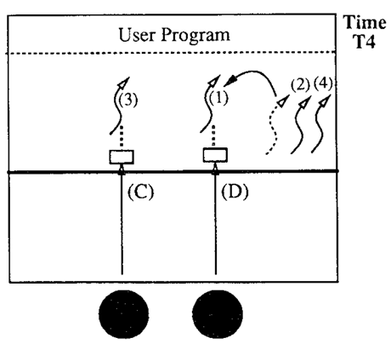
Threads Scheduler Activations – Example
T.E Anderson, Fig. 1 – Example I/O.
Finally, at time T4, the upcall takes a thread off the ready list and starts running it.

Slide 40
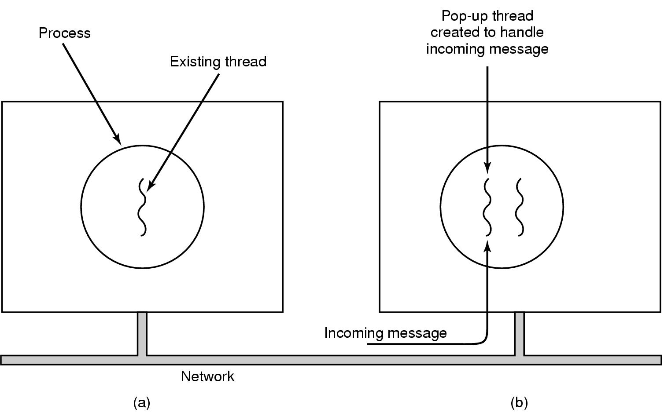
Threads Pop-Up Threads
Problem
The sender send the message to respond to the receiver's request
When the receiver waits the incoming message, it’s process or thread is blocked until the message arrives to process it
→ waste time to unblocked and reloaded thread information combining with unpacking the message, then parsing message’s content and processing it
Solution: using Pop-up threads
Handles the incoming message by the system creates a new thread that are brand new
This thread is identical to all the others, but it does not have any history (registers, stack, …) that must be restored
It can be implemented in kernel or user mode
Advantages
Create quickly (Do not have any threads information that must be stored)
The latency between message arrival and the start of processing can be made very short
Tanenbaum, Fig. 2-18.

Slide 41
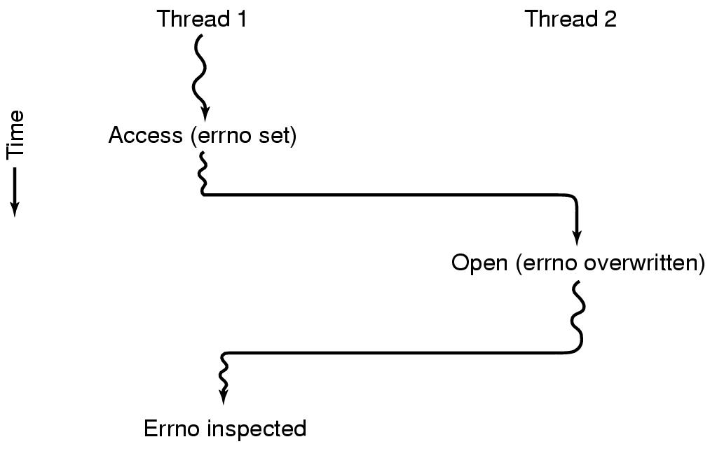
Threads Making Single-Threaded Code Multithreaded
Problem
Convert programs, that were written for single-thread processes, to multithreading
The global variables using in entire process can be a problem when the thread is used
Ex:
Tanenbaum, Fig. 2-19.

Slide 42
Threads Making Single-Threaded Code Multithreaded (2)
Solutions
Prohibit global variables altogether → conflicts with much existing software (modifying is impossible)
Assign each thread its own private global variables using private copy → allocate a chunk of memory for global variables and pass it to each procedure in the thread as an extra parameter
Use the library procedures with some methods as create_global, set_global, read_global → many library are not reentrant
Provide each procedure with a jacket that sets a bit to mark the library as in use → eliminates potential parallelism
Consider signals → are difficult to enough to manage a single threaded environment
Stack management with many stack that can be grown

Slide 43
Processes & Threads InterProcess Communication (IPC)

Slide 44
Objectives…
Interprocess communication
Overview
Race Conditions
Critical Regions
Mutual Exclusion with Busy Waiting
Disable Interrupts
Lock Variables
Strict Alternative
Peterson’s solution
TSL instructions
Sleep and wakeup
Semaphores
Mutexes
Monitors
Message Passing
Barriers

Slide 45
InterProcess Communication (IPC) Overview
How one process can pass information to another?
Make sure two or more processes do not get in each other’s way
Proper sequencing when dependencies are present: if process A produces data and process B prints them, B has to wait until A has produced some data before starting to print

Slide 46
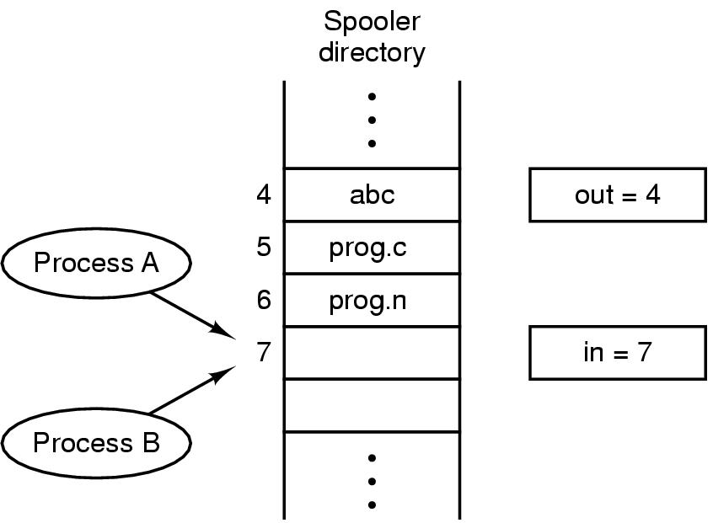
Race Conditions
A situation where several threads (or processes) manipulate the same (shared) data concurrently and the outcome of the execution depends on the precise order of what is happening when, is called a race condition
Ex
Other example in practically
The bank account has the balance as 800, and can withdraw with 2 ATM cards at different 2 locations at a time
First, the user1 pushes card to ATM machine and checking account’s balance. The process P1 is created simultaneously in server. Then the checking result is 800. The user choose withdrawing 400
Second, in the other location, the user2 also do same things as user1 and process P2 is created. The user choose withdrawing 500
In the case, if the P1 is out of time slice, the P2 is served first then user 2 gets 500. Later, does the user1 get 400 or get the error message?
The final state of a resource is unpredictable and could be inconsistent
Tanenbaum, Fig. 2-21.

Slide 47
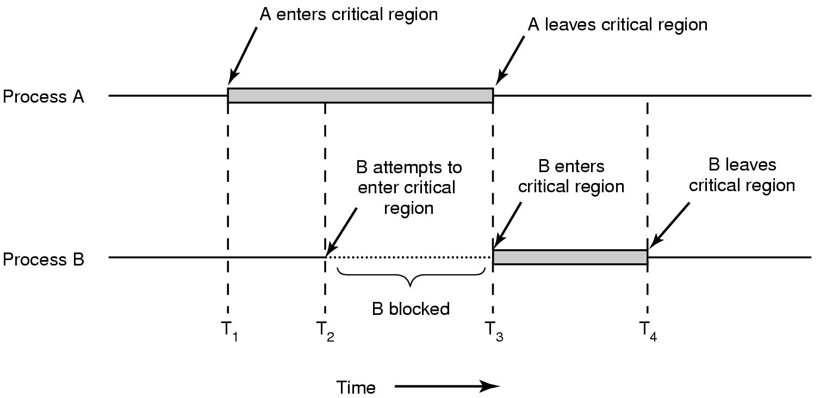
Critical Regions
The part of program where the shared memory is accessed (The code regions where race conditions appear)
Are the areas of code whose execution must be regulated to guarantee predictable results
To avoid races, we could arrange matters such that no two processes were ever in their critical regions
Conditions required to avoid race condition:
No two processes may be simultaneously inside their critical regions.
No assumptions may be made about speeds or the number of CPUs.
No process running outside its critical region may block other processes.
No process should have to wait forever to enter its critical region.
Tanenbaum, Fig. 2-22.

Slide 48
Mutual Exclusion with Busy Waiting
Mutual Exclusion
If one thread is executing in its critical section, no other threads can be executing in their critical sections (Only one process can use a shared resource at one moment)
Proposals for achieving mutual exclusion:
Disabling interrupts
Lock variables
Strict alternation
Peterson's solution
The TSL instruction
Sleep and Wakeup
Producer & Consumer
Semaphore, Mutex, Monitor
Barrier

Slide 49
A study problem
Time
Person A
Person B
3:00
Look in fridge. Run out of milk.
3:05
Go to the store.
3:10
Arrive at store.
Look in fridge. Run out of milk.
3:15
Buy milk.
Go to the store.
3:20
Arrive home, put milk away.
Arrive at store.
3:25
Buy milk.
3:30
Arrive home, put milk away.
Not a good cooperation => Too much milk.
Correctness requirements
Never more than one person buys milk (First Rule)
Someone buys if needed (Fourth Rule)
The solution of this case (mutual exclusion) is called an synchronization

Slide 50
Disabling Interrupts
On a single-processor system, each process
Disable all interrupts just after entering its critical region
Re-enable them just before leaving it
→ A process can examine and update shared memory without fear that any other process will intervene
Disadvantages
Give user processes the power to turn off interrupts (if a process dies while it is in its critical region → the system is indefinitely blocked)
On a multiprocessor, the disabling interrupts affects only the CPU that executed the disable instruction while the other ones will continue running and can access the shared memory
→ Disabling interrupts is often a useful technique within the OS itself but is not appropriate for user processes

Slide 51
InterProcess Communication (IPC) Lock Variables
while(TRUE) {
while (lock == 1); //waiting until lock sets to 0
lock = 1;
critical_region();
lock = 0;
nonCritical_region();
}
Process 1 | Process 2
while(TRUE) { while (lock == 1); lock = 1; critical_region(); lock = 0; nonCritical_region(); } | while(TRUE) { while (lock == 1); lock = 1; critical_region(); lock = 0; nonCritical_region(); }

Slide 52
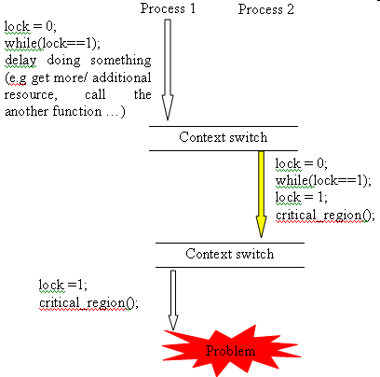
Lock Variables
The solution fails occasionally both processes can be simultaneously in their own critical regions
Process A reads the lock and sees that it is 0
Before it can set the lock to 1, Process B is scheduled, run, and set the lock to 1 (then Process A set the lock to 1)
Testing a variable until some value appears is called busy waiting (wastes CPU time)

Slide 53
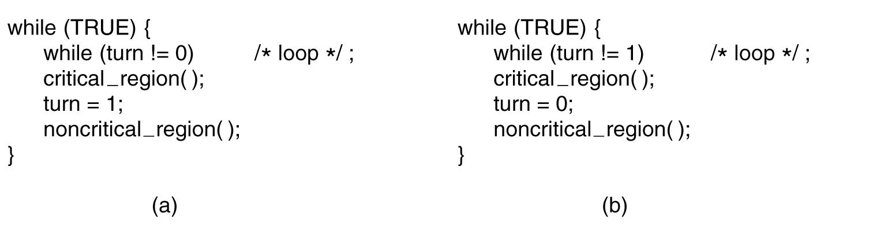
Strict Alternation
Tanenbaum, Fig. 2-23.
The two processes strictly alternate in entering their critical regions
Problems
Testing a variable until some value appears is called busy waiting (wastes CPU time)
A process is being blocked by another process not in its critical region
One of processes is much slower than the other
When one process dies, the other ones are blocked forever

Slide 54
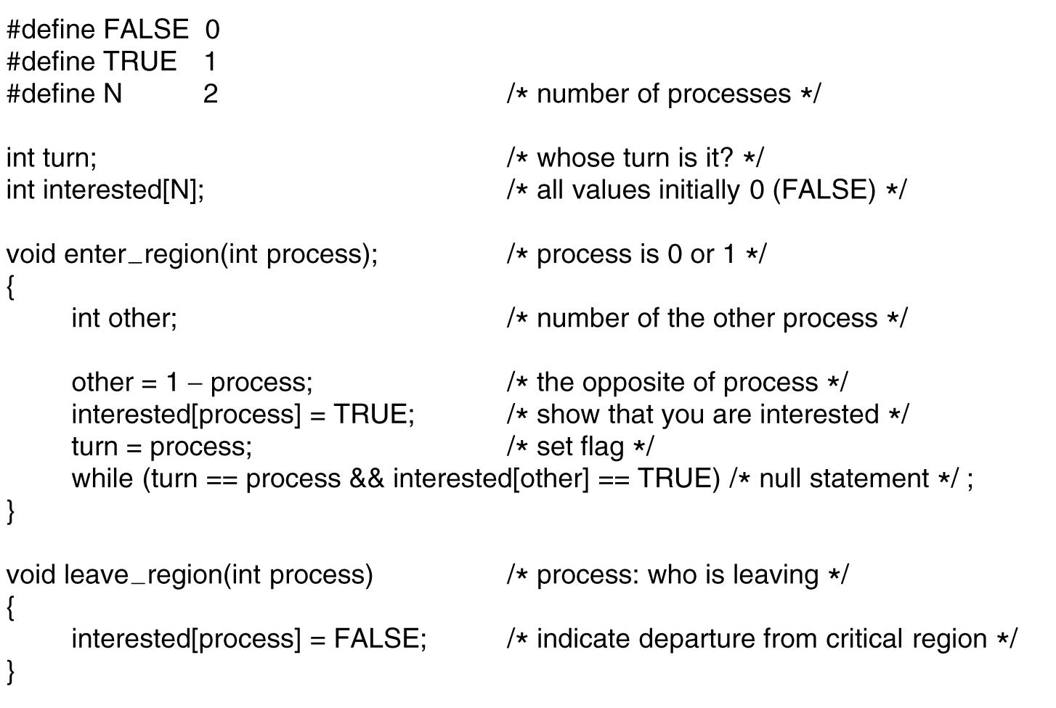
InterProcess Communication (IPC) Peterson’s Solution
Tanenbaum, Fig. 2-24.
Combines the idea of taking turns with the idea of lock variables and strict alternation

Slide 55
InterProcess Communication (IPC) Peterson’s Solution
Solution for process Pi
do {
enter_region(i);
critical_region();
leave_region(i);
nonCritical_region();
} while (TRUE);
Mutual exclusion is preserved (1st rule)
Pi enters its critical section only if either interested [j]=false or turn=j.
If both processes want to enter their critical sections at the same time, then interested [i] = interested [j] = true.
However, the value of turn can be either 0 or 1 but cannot be both. Hence, one of the processes must have successfully executed the while statement (to enter its critical section), and the other process has to wait, till the process leaves its critical section → mutual exclusion is preserved.

Slide 56
InterProcess Communication (IPC) Peterson’s Solution
The 3rd rule is satisfied.
Case 1:
Pi is ready to enter its critical section.
If Pj is not ready to enter the critical section (it is in the remainder section).
Then interested[j] = false, and Pi can enter its critical section.
Case 2:
Pi and Pj are both ready to enter its critical section.
interested[i] = interested [j] = true. And Either turn = i or turn = j.
If turn = i, then Pj will enter the critical section.
If turn = j, then Pi will enter the critical section
The 4th rule is met
Once Pj exits its critical section, it will reset interested [j] to false, allowing Pi to enter its critical section.
Even if Pj immediately resets interested [j] to true, it must also set turn to i.
Then, Pi will enter the critical section after at most one entry by Pj.

Slide 57
InterProcess Communication (IPC) The TSL (Test and Set Lock) Instruction
Instruction form: TSL RX, LOCK
Reads the content of the memory word lock into register RX
Stores a nonzero value at the memory address lock (sets to 1)
Both 2 above steps are made atomically (indivisible – no processor can access memory word until the instruction is finished)‏
Different from Disabling interrupts: disabling interrupts then performing a read on a memory word followed by a write does not prevent a second process on the bus from accessing the word between the read and the write
Solution: Each process calls
enter_region before entering its critical region
leave_region after leaving its critical region
TSL solution uses a lock variable. When lock is 0, a process using TSL to set lock to 1 and access the critical region. When it finishes, it set lock to 0
enter_region:
TSL REG, LOCK
CMP REG, #0
JNE enter_region
RET
leave_region:
MOVE LOCK, #0
RET

Slide 58
InterProcess Communication (IPC) The TSL (Test and Set Lock) Instruction
Mutual exclusion is preserved (1st rule)
When a process leaves its critical section, lock is set to 0
The 3rd rule is satisfied.
A process exiting the critical section either sets lock to 1
Both allow a process that is waiting to enter its critical section to proceed
The 4th rule is met
The implementation of process same as Peterson (using array to mark)

Slide 59
InterProcess Communication (IPC) Sleep and Wakeup
Both Peterson and TSL have defect of requiring “busy waiting“
Waste CPU time
Priority inversion

Slide 60
InterProcess Communication (IPC) Sleep and Wakeup
Both Peterson and TSL have defect of requiring “busy waiting“
Waste CPU time
Priority inversion
CPU
Critical Regions
Priority: 5
B

Slide 61
InterProcess Communication (IPC) Sleep and Wakeup
Both Peterson and TSL have defect of requiring “busy waiting“
Waste CPU time
Priority inversion
CPU
Critical Regions
Priority: 5
A
B
New → Ready, Priority: 2

Slide 62
InterProcess Communication (IPC) Sleep and Wakeup
Both Peterson and TSL have defect of requiring “busy waiting“
Waste CPU time
Priority inversion
CPU
Critical Regions
Priority: 5
Time-out
A
B
New → Ready, Priority: 2

Slide 63
InterProcess Communication (IPC) Sleep and Wakeup
Both Peterson and TSL have defect of requiring “busy waiting“
Waste CPU time
Priority inversion
CPU
Critical Regions
Priority: 5
A
B
New → Ready, Priority: 2

Slide 64
InterProcess Communication (IPC) Sleep and Wakeup
Both Peterson and TSL have defect of requiring “busy waiting“
Waste CPU time
Priority inversion
Violate 4th rule
CPU
Critical Regions
Priority: 5
Time-out
A
B
New → Ready, Priority: 2

Slide 65
InterProcess Communication (IPC) Sleep and Wakeup
Both Peterson and TSL have defect of requiring “busy waiting“
Waste CPU time
Priority inversion
Violate 4th rule
Solution: the pair sleep and wakeup is used to direct blocking instead of wasting CPU time when the processes are not allowed to enter their critical regions
Sleep is a system call that causes the caller to block, that is, be suspended until the another process wakes it up
Wakeup call has one parameter, the process to be awakened (ready)
Alternatively, both sleep and wakeup each have one parameter, a memory address used to match up sleeps and wakeups
CPU
Critical Regions
Priority: 5
Time-out
A
B
New → Ready, Priority: 2

Slide 66
InterProcess Communication (IPC) Producer-Consumer Problem
Producer
Consumer
Is known as the bounded-buffer problem
Two processes share comment, fixed-size buffer
The producer puts information into the buffer
The consumer takes it out
Sleeping conditions
For producer, buffer full
For consumer, buffer empty
Wakeup conditions
For producer, there is space in buffer
For consumer, there are messages in buffer

Slide 67
InterProcess Communication (IPC) Semaphores
(E.W.Dijkstra, 1965):
A new variable type (semaphore) could have
The value 0: no wakeups were saved
The positive value: one or more wakeups were pending
Two operations
down (sleep)
Checking the semaphore value is greater than 0
If so, it decrements its value & continues, otherwise blocks the current process
checking the value, change it, and possibly going to sleep, are all done as single, indivisible atomic action
Once a semaphore operation has started, no other process can access the semaphore until the operation has completed or blocked
up (wakeup)
increments the semaphore’s value and wakes up a sleeping process (indivisible)
no process ever blocks doing an up, just as no process ever blocks doing a wakeup in the earlier model
Semaphores solve the lost-wakeup problem

Slide 68
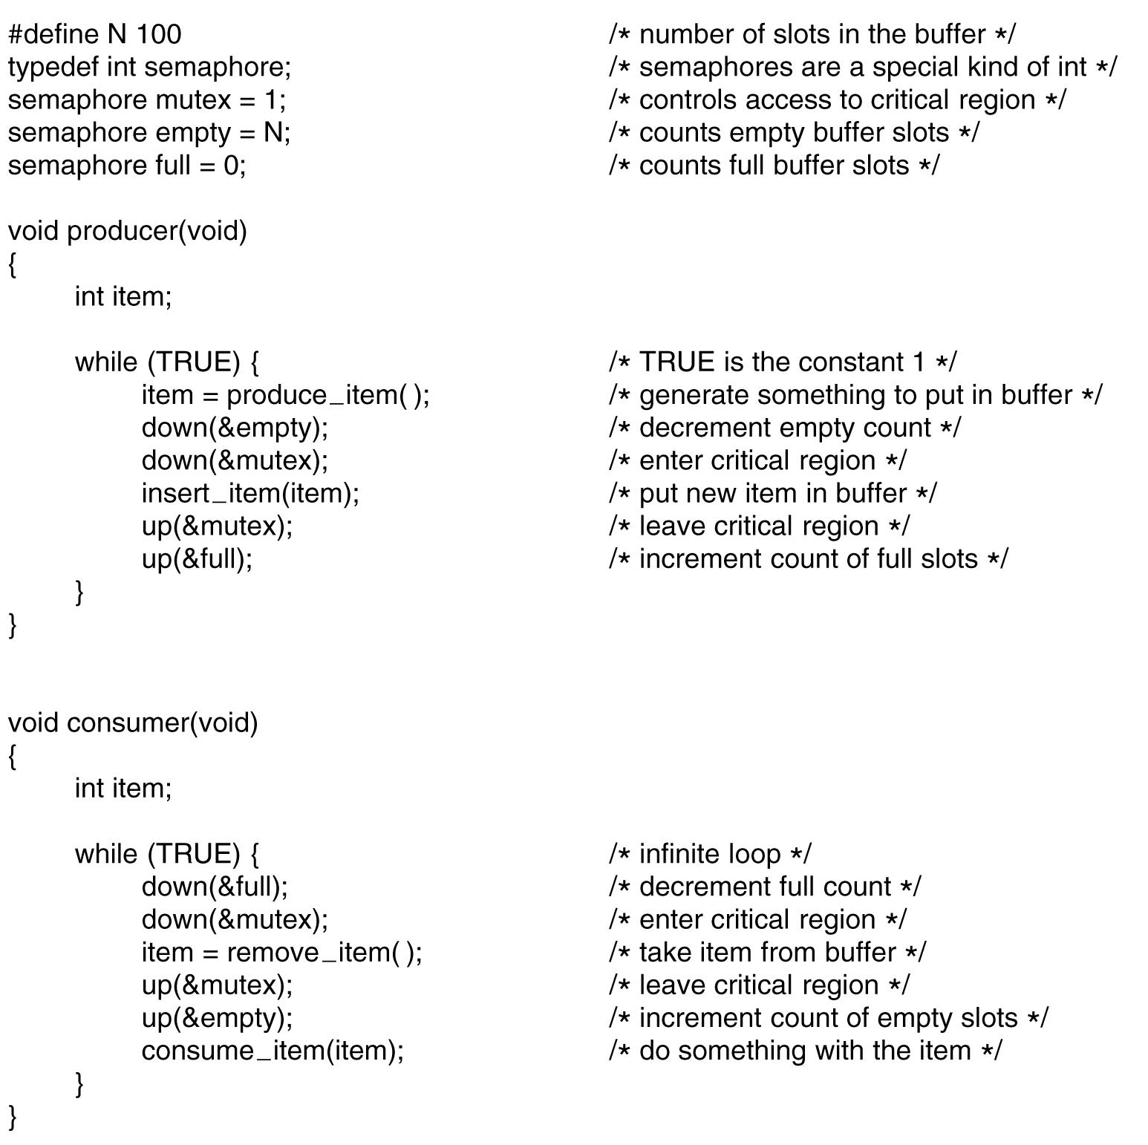
InterProcess Communication (IPC) Solving Producer-Consumer Problem
Uses 3 semaphores
full: counting the full slots (0)
empty: counting the empty slots (n slots)
mutex: make sure the producer and consumer do not access the buffer (1)

Slide 69
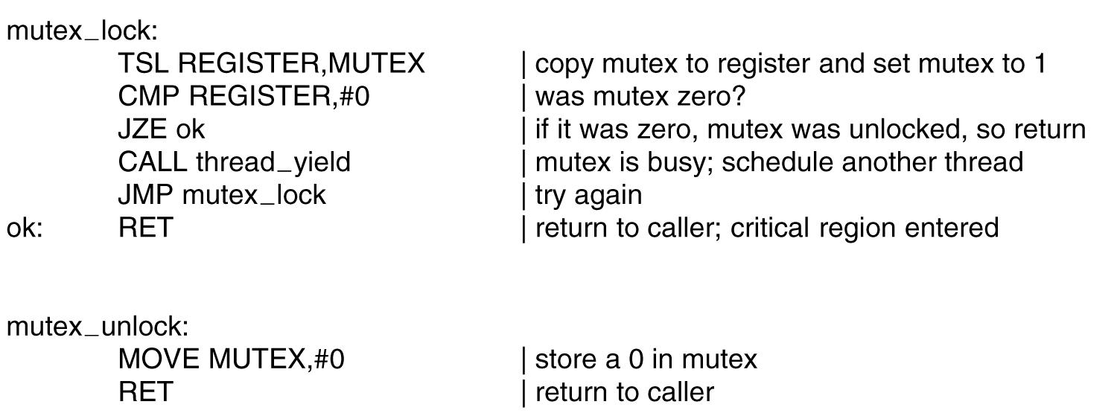
InterProcess Communication (IPC) Mutexes
Good for managing mutual exclusion to some shared resource or piece of code (it is easy and efficient to implement using thread in user mode)
A mutex is a variable that can be in one of two states
unlocked (0): the calling threads is free to enter the critical region
locked (1): the calling thread is blocked until the thread in the critical region is finished (busy)
Two procedures are used
mutex_lock: is called when a thread needs access to a critical region
mutex_unlock: is called when a thread in the critical region is finished

Slide 70
InterProcess Communication (IPC) Monitors
Is a proposal of Brinch Hansen (1973) and Hoare (1974)
Is a collection of procedures, variables, and data structures that are all grouped together in a special kind of module or package
Processes may call the procedures in a monitor whenever they want to, but they cannot directly access monitor‘s internal data structures from procedures declared outside the monitor (encapsulation)
Only one process can be active in a monitor at any moment (mutual exclusion)
Monitor are programming language constructs
When a process calls a monitor procedure, it must check to see if any other procedure in currently active within monitor
If so, the calling process is suspended until the other leaves.
Otherwise, it enters the monitor
Monitor are implemented using
Mutual exclusion in monitor is ensured by the compiler
Condition variables: provide the possibility of waiting

Slide 71
InterProcess Communication (IPC) Condition Variables
Used to wait for a specific condition to be fulfilled
Two operations
wait(): current process sleep, waiting (block state)
signal(): a sleeping process is awaked
When a process call wait, the other processes get access into the monitor
The wait must come before the signal and keep track the state of each process with variables to ensure the signal losing

Slide 72
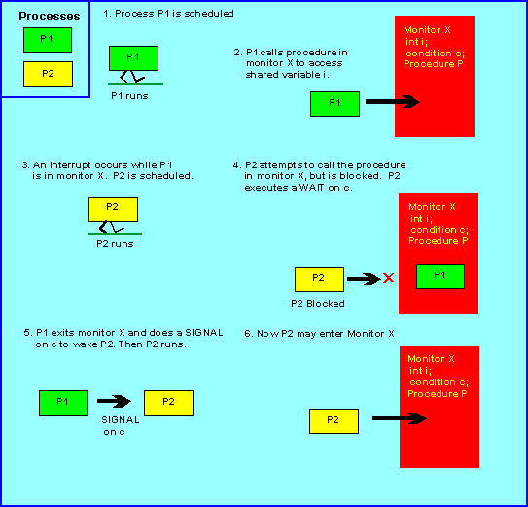
InterProcess Communication (IPC) Monitor functions

Slide 73
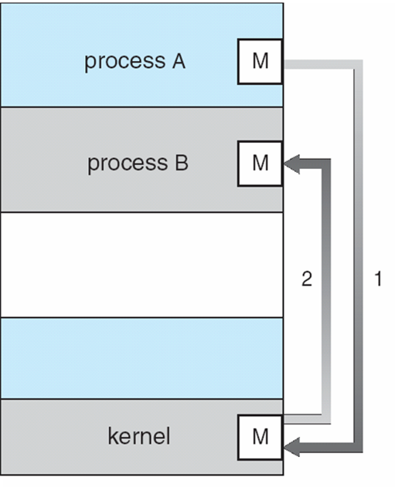
InterProcess Communication (IPC) Message Passing
Using system calls (like semaphore) with 2 primitives
send (destination, &message): sends a message to given destination
receive (source, &message): receives a message from a given resource. If no message is available, the receiver can block until one arrives
Message-Passing System is used for the communicating processes are on different machines connected by a network
To guard against lost messages, sender and receiver can agree that as soon as a message has been received, the receiver will send back a special acknowledgement message (ensuring both process are not blocked forever)

Slide 74
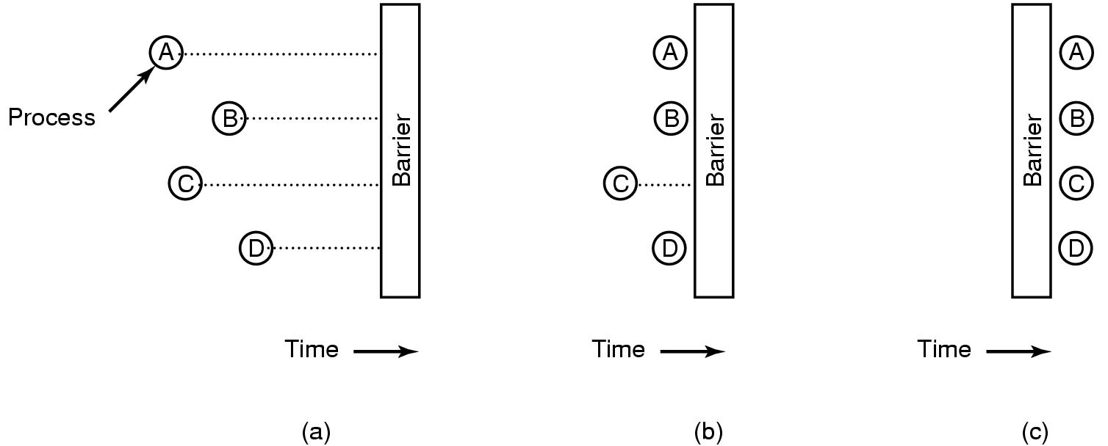
InterProcess Communication (IPC) Barriers
Is intended for groups of processes rather than two process producer-consumer type situations
The applications are divided into phases and have the rule that no process may proceed into the next phase until all processes are ready to proceed to the next phase.
This behavior may be archived by placing a barrier at the end of each phase. When a process reaches the barrier, it is blocked until all processes have reached the barrier.
Tanenbaum, Fig. 2-37.

Slide 75
Processes & Threads Scheduling

Slide 76
Objectives
Scheduling
Introduction
Process Behavior
When to schedule
Categories of Scheduling algorithms
Criteria/ Properties Term
Scheduling in Batch System

Slide 77
Scheduling Introduction
Scheduler
OS component that decides what process will be run and for how long
Uses a scheduling algorithm
On OSs that support kernel-level threads, it is threads that are being scheduled
History
In the old days of batch system with input the form of card images on a magnetic tape: just run the next job on the tape
In early computers, CPU time was a scarce resource: good scheduling was of paramount importance!
Nowadays, the CPU is not a scarce resource any more! Furthermore, in PCs there aren’t many users competing… However, scheduling algorithms have become more sophisticated!

Slide 78
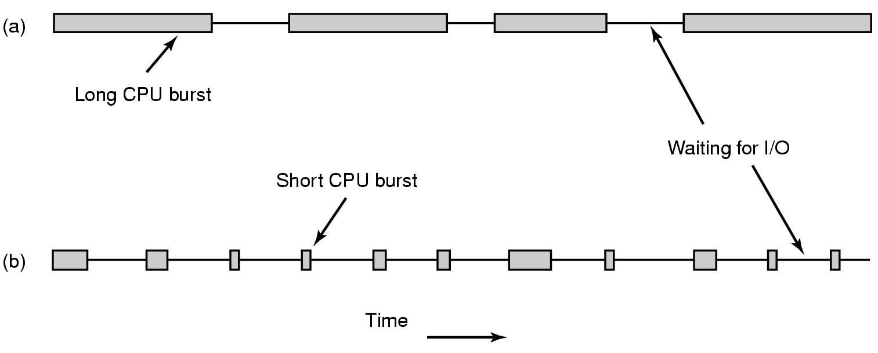
Scheduling Process Behavior
All process execution consists of a cycle of bursts of computing (CPU execution) and I/O request (I/O wait)
Compute-bound processes
Spend most of their time computing
Have long CPU bursts and thus infrequent I/O waits
I/O-bound processes
Spend most of their time waiting for I/O
Have short CPU bursts and thus frequent I/O waits
Tanenbaum, Fig. 2-38.

Slide 79
Scheduling Process Behavior
Example
load store
add store
read from file
CPU burst
Process execution begin with CPU burst, then I/O burst … the last CPU burst will end with a system request to terminal execution
wait for I/O
I/O burst
store increment index
write to file
CPU burst
wait for I/O
I/O burst

Slide 80
Scheduling When to schedule
A key issue related to scheduling is when to make scheduling decisions
Process creation
A decision needs to be made whether run the parent or child process
Process termination
A decision must be made when a process exits. That process can no longer run, so some other process must be chosen from the set of ready processes. If no process is ready, a system-supplied idle process is normally run
Process blocking
When a process blocks, another process has to be selected to run

Slide 81
Scheduling When to schedule
Interrupt occurrence
If the interrupt came from an I/O device that has now completed its work, some process that was blocked waiting for the I/O may now be ready to run
Clock interrupt occurrence
non-preemptive scheduling algorithms
preemptive scheduling algorithms
CPU scheduling decisions may take place when a process:
Switches from running to blocked state (I/O or wait for child processes).
Switches from running to ready state (interrupted).
Switches from blocked to ready (completion of I/O).
Terminates.
→ The process executes following above steps in order, we can say it is scheduled in non-preemptive. Otherwise, it is scheduled in preemptive
Notes:
Non-preemptive: k ưu tiên

Slide 82
Scheduling When to schedule
non-preemptive scheduling algorithms
Picks a process to run and then just lets it run until it is blocked or until it voluntarily releases the CPU (will not be forcibly suspended, no scheduling decisions)
Once a process is in the running state, it will continue until it terminates or blocks itself for I/O
Applying to the batch system
preemptive scheduling algorithms
The process can run (continuously) for a maximum of some fixed time. If it is still running at the end of this time, it is suspended and the scheduler will pick another process to run (needs timer)
Currently running process may be interrupted and moved to the Ready state by the operating system
Allows for better service since any one process cannot monopolize the processor for very long
Applying to the time-sharing or real time
Notes:
Monopolize: độc quyền

Slide 83
Scheduling Categories of Scheduling Algorithms
Batch
Non-preemptive algorithms
Preemptive algorithms with long time periods for each process
Reduces processes switches and increase performance
Interactive
Preemptive algorithms are needed to prevent the situation that the preemptive keeps one process from hogging the CPU and denying service to the others. Even if no process intentionally ran forever, one process might shut out all the others indefinitely due to a program bug
Real-Time
Preemption normally used, but sometimes not needed because the processes know that they may not run for long periods of time and usually do their work and block quickly

Slide 84
Scheduling Criteria/ Properties Term
Fairness – equivalent processes get equivalent CPU times
Policy enforcement – if the local policy is that safety control processes get to run whenever they want to, even if it means the payroll is 30 sec late, the scheduler has to make sure this policy enforced
Policy vs. Mechanism
The policies what is to be done
The mechanism specifies how it is to be done
The mechanism is a thing that implements the policy
Ex:
The timer construct for ensuring CPU protection (mechanism)
The decision of how long the timer is set for a particular user (policy)

Slide 85
Scheduling Criteria/ Properties Term
Throughput
The number of processes that complete their execution per time unit.
Ex: In long processes, the rate may be one process per hour. For short processes, it may be 10 processes per second.
Turnaround time
Amount of time to execute a particular process.
Is the sum of the periods spent waiting in the ready queue, executing on the CPU, doing I/O, etc…
Is the time from the process is submitted until it is completed (time of completion – arrival time)

Slide 86
Scheduling Criteria/ Properties Term
CPU utilization
The utilization of CPU.
Can range from 0 to 100 percent.
It should range from 40 percent (lightly loaded system) to 90 percent (heavily used system).
Response time
In an interactive system, turnaround time may not be the best criterion.
Often, a process can produce some output fairly early and can continue computing new results.
This measure is the amount of time it takes from when a request was submitted until the first response is produced.
Proportionality
When a request that is perceived as complex takes a long time, users accept that, but when a request that is perceived as simple takes a long time, users get irritated
Notes:
Proportionality: tương xứng

Slide 87
Scheduling Categories of Scheduling Algorithms
All systems
Fairness – giving each process a fair share of CPU
Policy enforcement – seeing that stated policy is carried out
Balance – keeping all parts of the system busy
Batch systems
Throughput – maximize jobs per hour
Turnaround time – minimize time between submission and termination
CPU utilization – keep the CPU busy all the time
Interactive systems
Response time – respond (react) to request quickly
Proportionality – meet user’s expectations
Real-time systems
Meeting deadlines – avoid losing data
Predictability – avoid quality degradation in multimedia systems

Slide 88
Scheduling in Batch System First-Come First Served (FCFS)
The simplest CPU scheduling algorithm!
Is non-preemptive
The process that entered the ready state first, will get the CPU first and will hold it until it is blocked (or finished)
Simple to understand and implement
It requires a single queue of ready processes:
If a process enters the ready state, it is linked onto the tail of the ready queue.
If the CPU is free, it takes the process at the head.

Slide 89
Scheduling in Batch System First-Come First Served (FCFS)
CPU
tail
head
…

Slide 90
Scheduling in Batch System First-Come First Served (FCFS)
CPU
P
tail
head
…
New

Slide 91
Scheduling in Batch System First-Come First Served (FCFS)
CPU
tail
head
…

Slide 92
Scheduling in Batch System First-Come First Served (FCFS)
CPU
P
tail
head
…
New

Slide 93
Scheduling in Batch System First-Come First Served (FCFS)
CPU
tail
head
…

Slide 94
Scheduling in Batch System First-Come First Served (FCFS)
CPU
tail
head
…

Slide 95

Scheduling in Batch System First-Come First Served (FCFS)
CPU
tail
head
…
Waiting time of each process: started process time – arrival time
Ex:
(Process:BurstTime) in order (P1:24), (P2:3), (P3:3)
Waiting time for P1 = 0; P2 = 24; P3 = 27
Average waiting time: (0 + 24 + 27)/3 = 17
Average Turnaround time: (24 + 27 + 30)/3 = 27

Slide 96
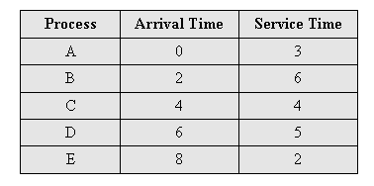
Scheduling in Batch System Example
Avg waiting time = 4.6
Avg turnaround time = 8.6
0
5
10
15
20
A
B
C
D
E

Slide 97

Scheduling in Batch System Shortest Job First (SJF)
Runtime is known in advance (nonpreemptive)
When several equally important jobs are sitting in the input queue waiting to be started, the scheduler picks the shorted job first
Another more appropriate term – shortest-next-CPU-burst scheduling algorithm
When the CPU is available, it is assigned to the process that has the smallest next CPU burst
Is the optimal algorithm (only) when all the jobs are available simultaneously
Ex:
(Process:BurstTime) (P1:6), (P2:8), (P3:7), (P4: 3)
Average waiting time: (3+ 16 + 9 + 0)/4 = 7
Average turnaround time: (3 + 9 + 16 + 24)/4 = 13
Notes:
0 -> 2 -> 6 -> 12 -> 20 -> 30

Slide 98
Scheduling in Batch System Example
Avg waiting time = 3.6
Avg turnaround time = 7.6
0
5
10
15
20
A
B
C
D
E

Slide 99
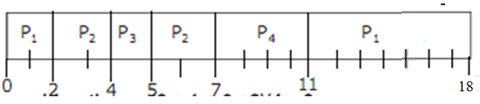
Scheduling in Batch System Shortest Remaining Time Next (SRT)
Is a preemptive version of shortest job first
The scheduler always chooses the process whose remaining runtime is the shortest
Preempt the currently executing process, if the next CPU burst of the newly arrived process is shorter than “what is left” of the currently executing process
When a new job arrives, its total is compared to the current process’s remaining time.
If the new job needs less time to finish than the current process, the current process is suspended and the new job started
Ex:
(Process:ArrivalTime:BurstTime) (P1:0:9), (P2:2:4), (P3:4:1), (P4:5:4)
Average waiting time: (9+ 1+ 0 + 2)/4 = 3
Average turnaround time: (18 + 5 + 1 + 6)/4 = 7.5

Slide 100
Scheduling in Batch System Example
Avg waiting time = 3.2
Avg turnaround time = 7.2
0
5
10
15
20
A
B
min(1, 6)
Min(5, 4)
C
Min(5, 5, 2)
E
Min(5, 2, 5)
D
Min(5, 5)

Slide 101
Processes & Threads Scheduling Classical IPC Problem

Slide 102
Objectives
Scheduling
…
Scheduling in Interactive System
Scheduling in Real-time System
Thread schedulings
Classical IPC Problems
The Dining Philosophers Problem
The Readers and Writers Problem

Slide 103

Round-Robin Scheduling (RR)
Each process is assigned a time interval (time quantum or slice)
Is a preemptive algorithm
Think of First-Come-First-Served, but with the following addition:
A process can hold the CPU for a maximum of quantum or time slice; if it still running at the end of the quantum, the CPU is preempted and given to process at the head of the ready queue; the process that was running is moved to the tail of the ready queue (ready queue is treated as circular queue)
If the process has blocked or finished before the quantum has elapsed, the CPU switching is done the process blocks
The length of the quantum
Too short → lower the CPU efficiency and causes too many process switches
Too large → poor response to short interactive requests (FCFS)
20-50 msec is a reasonable compromise
Ex: (Process:BurstTime) (P1:24), (P2:3), (P3:3) with quantum = 4
Average waiting time = (6 + 7 + 4)/3 = 5.7
Average turnaround time = (30 + 7 + 10)/ 3 = 15.6

Slide 104
Scheduling in Interactive Systems Example (quantum = 1)
Avg waiting time = 6.8
Avg turnaround time = 10.8
0
5
10
15
20
A
B
C
D
E

Slide 105
Scheduling in Interactive Systems Priority Scheduling
Each process has a priority assigned
The greatest priority runnable process is always run
Give a chance to other processes → change the priority of the running process or assign it a quantum
Priorities assignment
Statically
Static (or externally defined) priorities are predetermined for each process: E.g., the process of the boss; or the process of the guy who paid more than others to run on this machine
Dynamically
Dynamic (or internally defined) priorities are assigned by the system to achieve certain goals: E.g., boost the priority of I/O-bound processes

Slide 106

Priority Scheduling
Ex: (Process:BurstTime:Priority)
(P1:10:3), (P2:1:1), (P3:2:4), (P4:1:2)
Average waiting time: (2 + 0 + 12 + 1)/ 4 = 3.75
Average turnaround time: (12 + 1 + 14 + 2)/ 4 = 7.25
Problem
Starvation: The low priority processes can be waited indefinitely (cannot be executed if the system occurred errors in runtime) for CPU by higher priority processes
Solution
Aging: Is a technique of gradually increasing the priority of processes that wait in the system for a long time (using the clock interrupt)
Ex: every 15 minutes, decreasing the priority of a waiting process from (1 → 127), means that the priority with 127 → 1 at least 32 hours

Slide 107
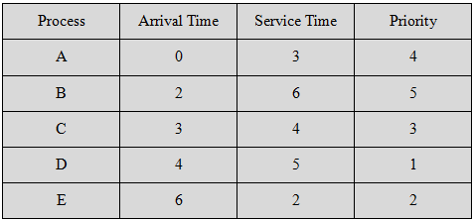
Scheduling in Interactive Systems Example
Avg waiting time = 4.2
Avg turnaround time = 8.2
0
5
10
15
20
A
B
C
D
E

Slide 108
Scheduling in Interactive Systems Multiple Queues
One simple way of mapping priorities onto actual scheduling decisions would be to give to each process a time slice related to its priority (e.g., more time slice to higher-priority threads)
A more convenient approach is to view the ready state as not only one queue of processes, but multiple queues, each with its own priority!
Again, several options may exist:
Processes of queues of higher priority may have to complete before processes of queues of lower priority start running!
Higher priority queues may get more time than lower priority queues!
Processes may move between queues (dynamically adjusted priority)

Slide 109
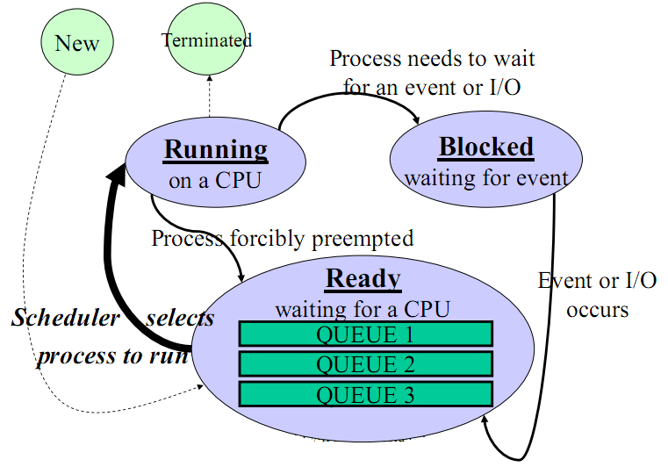
Scheduling in Interactive Systems Multiple Queues

Slide 110

Scheduling in Interactive Systems Shortest Process Next (SPT)
Non-preemptive policy
Is to make estimates based on past behavior and run process with the shortest estimated running time
The technique of estimating the next value in a series by taking the weighted average of the current measured value and the previous estimate is sometimes (aging with special value as ½, 0 ≤ aging ≤ 1)
Suppose that the estimated time per command for some terminal is T₀ . T₁ is next run. The estimate by taking a weighed sum of these two numbers is
aT₀ + (1 – a)T₁ (general: T_{n+1} = aT_{n} + (1 – a)τ_{n+1})
Ex:

Slide 111
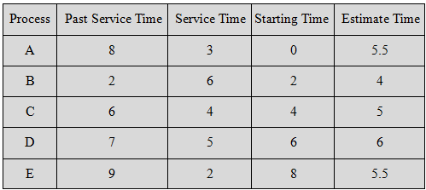
Scheduling in Interactive Systems Example
0
5
10
15
20

Slide 112
Scheduling in Interactive Systems Example
Avg waiting time = 5.9
Avg turnaround time = 11.1
0
5
10
15
20
A
B
C
D
E

Slide 113
Scheduling in Interactive Systems Guaranteed Scheduling
If a single-user system with n processes running, each one should get 1/n of the CPU cycles (fairness)
Mechanism
The system must keep track of how much CPU each process has had since its creation.
Then, the system computes the amount of CPU each one is entitled to, namely the time since creation divided by n
The algorithm is then to run the process with the lowest ratio until its ratio has move above its closest competitor

Slide 114
Scheduling in Interactive Systems Lottery Scheduling
Give processes lottery tickets
More important processes can be given extra tickets (to increase their odds of winning)
Whenever a scheduling decision has to made, a lottery ticket is chosen at random, and the process holding that ticket gets the resource
Lottery scheduling is highly responsive
Lottery scheduling can be used to solve problems that are difficult to handle with other methods

Slide 115
Scheduling in Interactive Systems Fair-Share Scheduling
Each process is scheduled on its own, without regard to who its owner is. As a result, if user 1 starts up 9 processes and user 2 starts up 1 process, with round robin or equal priorities, user 1 will get 90% of the CPU and user 2 will get only 10% of it
To prevent this situation, some systems take into account who owns a process before scheduling it. In this model, each user is allocated some fraction of the CPU and the scheduler picks processes in such a way to enforce it. Thus if two users have each been promised 50% of the CPU, they will each get that, no matter how many processes they have in existence

Slide 116
Scheduling in Interactive Systems Fair-Share Scheduling
The system has 2 users A and B
User A has 4 processes A, B, C, D
User B has 1 process E
How is the Fair Share Scheduling applied to this system using the Round-Robin scheduling?
→ A E B E C E D E ….
How is the Fair Share Scheduling applied to this system using the Round-Robin with quantum equal 2
→ A B E (2) C D E(2) A B E(2) C D E(2) …

Slide 117
Scheduling in Real-Time Systems
Context
A real-time system is one in which time plays an essential role
A real-time system has two kinds as hard real time and soft real time
A real-time system divides the program into a number of processes whose behavior is predictable and known in advance.
These processes are generally short lived and can run to completion in well under a second.
→ The scheduler schedules the processes in such a way that all deadlines are met
Static scheduling (applied to hard real-time)
Make their scheduling decisions before the system starts running
Only works when there is perfect information available in advance about the work to be done and the deadlines that have to be met
Dynamic scheduling (applied to soft real-time)
Make their scheduling decisions at runtime
Do not have static’s restrictions

Slide 118
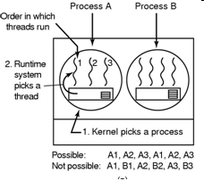
Thread Scheduling User-level Threads
The kernel scheduler schedules the process
The thread scheduler in each process decides which thread to run
If any thread have long CPU burst, this thread will consume all of process’s time (until it finishes) because the user mode does not support clock interrupt.
Otherwise, each thread runs for a little, then it return the CPU back to the thread scheduler before the kernel allocate quantum to other process.
Round-robin and priority scheduling is applied
Switching a thread takes a handful of machine instructions
The user-level threads can employ an application specific thread scheduler because it know what all the threads do to pick the needing thread to run
Tanenbaum, Fig. 2-43.

Slide 119
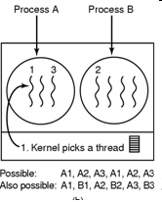
Thread Scheduling Kernel-level Threads
The kernel scheduler schedules the thread
However, a kernel requires a full text switch (changing a memory map, invalidating caching … )
Moreover, the kernel would never know what each thread did
→ User-level thread has more performance than kernel-level thread in scheduling
Tanenbaum, Fig. 2-43.

Slide 120
The Dining Philosophers Problem
Classical IPC Problems
Five philosophers are seated around a circular table
Each philosopher has a plate with spaghetti
Between each pair of plates is one fork
A philosopher needs two forks to eat
A philosopher eats (not thinks) and thinks (not eats)
When he/she gets hungry, he/she tries to pick up the two forks that are closer him/her
Obviously, he/she can not pick up forks that is already in the hand of a neighbour
When he/she has finished eating, he/she puts down both forks and starting thinking again

Slide 121

The Dining Philosophers Problem
Classical IPC Problems
It represents the need to allocate several resources among several processes in
A deadlock (all of them take their left forks simultaneously. None will be able to take their rights fork)
Starvation (all of them could start the algorithm simultaneously, pick up their left forks, seeing that their right forks were not available, putting down their left forks, waiting, and picking up … forever)

Slide 122
Classical IPC Problems
The Dining Philosophers Problem
A random solution
The philosophers would just wait a random time instead of the same time after failing to acquire the right hand fork (that means all applications trying again later)
However, it doesn’t work all the time
An adequate solution (applying binary semaphore)
Before starting to acquire forks, a philosopher would do a down on mutex
After replacing the forks, he/she would do an up on mutex
However, it has a performance bug (in practical), only one philosopher can be rating at any instant instead of two ones)
Solution: uses an array of state and semaphore combine with binary semaphore allowing the maximum parallelism for arbitrary number of philosophers by keeping track of others.

Slide 123
Classical IPC Problems
The Readers and Writers Problem
Models access to a database (file)‏
A process that read data = reader
A process that modify data = writer
If two readers access the shared data simultaneously, no adverse affects will result
Multiple readers are allowed, but not at the same time with a writer
Only one writer is allowed to act on the database at one moment
Solution: The readers-writers problem has several variations, all involving priorities.
The first readers-writers problem:
No reader will be kept waiting unless a writer has already obtained permission to use the shared object.
Or, no reader should wait for other readers to finish.
Or readers have higher priorities.
The second readers-writers problem:
Once a writer is ready, the writer performs its write as soon as possible.

Slide 124
Summary
Scheduling
Classical IPC Problem
Q&A

Slide 125
Next Lecture
Memory Management
No Memory Abstraction (from Single to Multiple programs)
Memory Abstraction (mechanism and policy applied to manage memory)
Virtual Memory (mechanism and policy applied to manage memory)
Page replacement algorithms (applying to manage memory)

